Slide 1
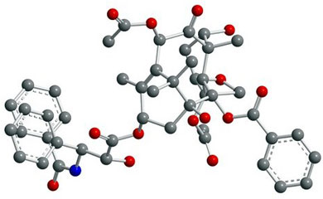
Project Milestone
Step 1
Step 2
Step 3
Step 4
Bond Type
Bond Angle
Dihedral Angle
Final Molecule
Bond Length
Atom Coordinates of Nearest Neighbors (k =1)
Atom Coordinates of Near Neighbors (k = 2, 3 or 4)
Atom Coordinates of All atoms
?
?
?

Slide 2
